Slide 1



INTRODUCTION to SageMaths
What is SageMaths ?
SageMaths is a free and open Source Mathematical Software
In fact it is a Sophisticated Computer Algebra System (CAS ).
By CAS mean a Mathematical software that can do the following things
Numerical Computations
Symbolic Computations and Manipulations
Graphing 2d and 3d objects
Programming

Slide 2

Others Commercial CAS are Mathematica, MatLab, Maple, Magma, MathCad
SageMath in other hand is open Source Mathematical Software and has capability of most of these software.
SageMath was initially developed by Prof. Willian Steain (Formerly at the University of Washington) and released in 2005 in Harvard University. Currently it has version 9.1.
Talk on Origin of SageMath by Prof. Willian Steain on following Link.
https://www.youtube.com/watch?v=6eIoYMB_0Xc&t=539s

Slide 3

What we can do with SageMath?
SageMath can be use as an advanced scientific calculator.
SageMath can also do complex and heavy duty Numerical Computations.
SageMath can be use for visualization and animation .
Very good at symbolic manipulation arising in various branches in mathematics such as Calculus , Linear algebra, Abstract algebra, Number theory , Graph theory, combinatorics , differential geometry etc.
SageMath does not have its own specialized language. The mainstream Programming language of SageMath is PYTHON.

Slide 4


Installing SageMath on Window
To install SageMath on window just download the windows installer binary and run it.
Link for Step by step guide for installation on window
https://wiki.sagemath.org/SageWindows
Website for to download SageMath
https://www.sagemath.org/
Following are steps for installation.
Go to website https://www.sagemath.org/

Slide 5
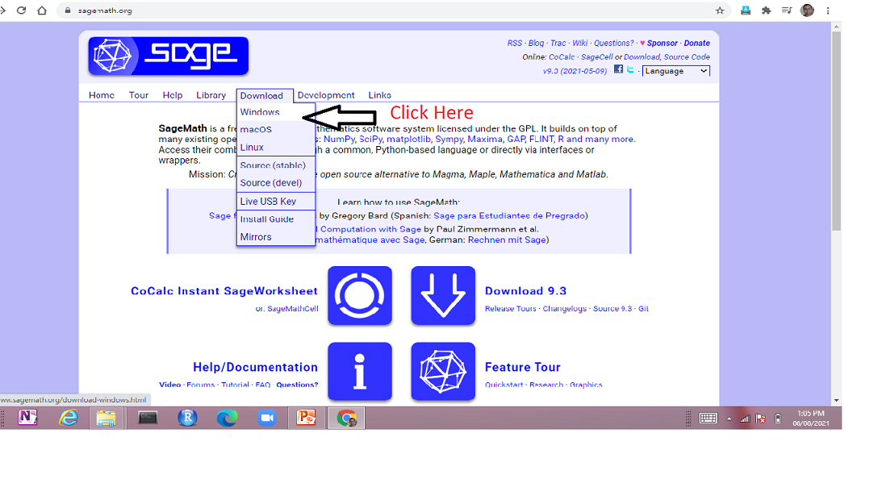

Slide 6
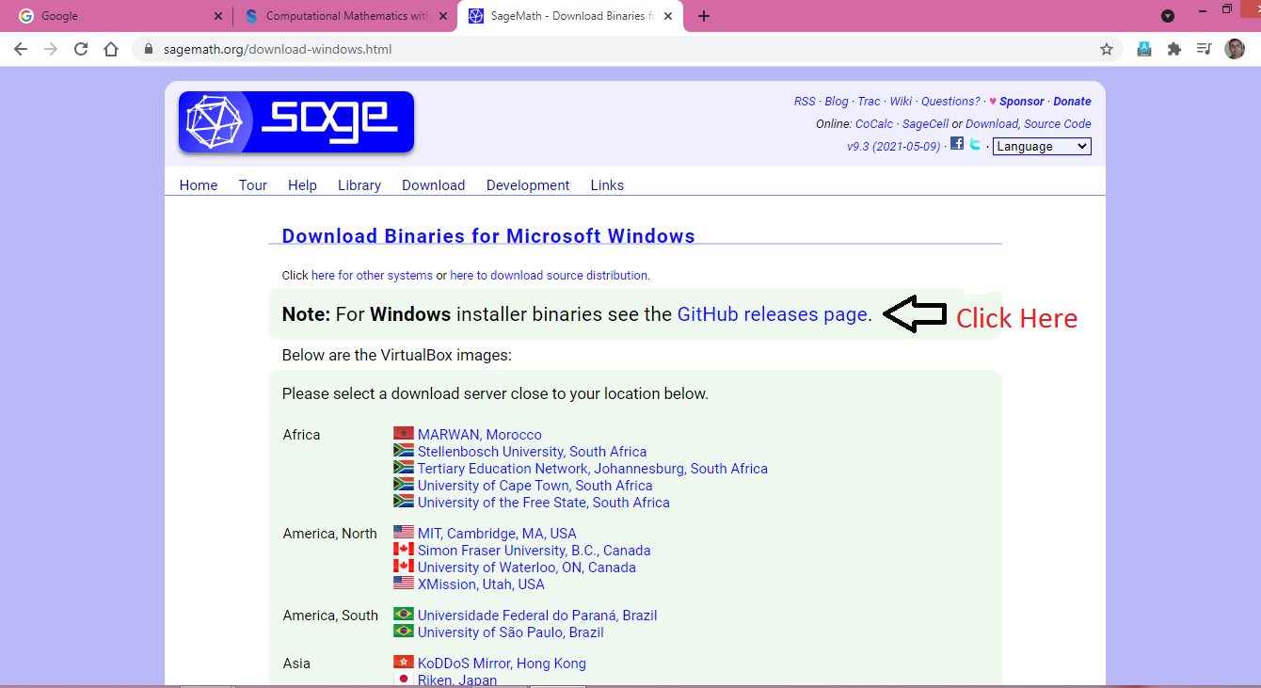

Slide 7
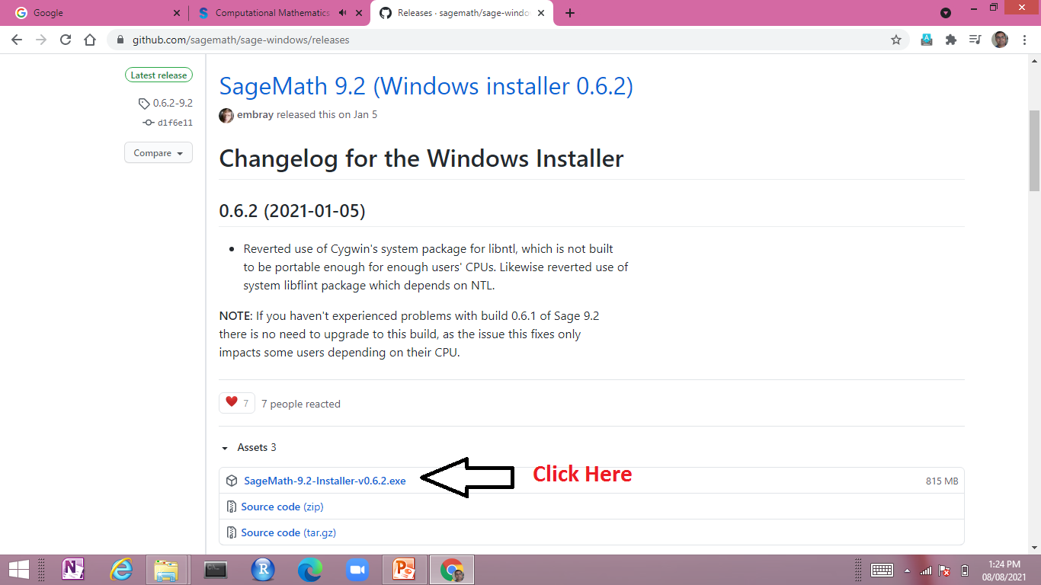

Slide 8
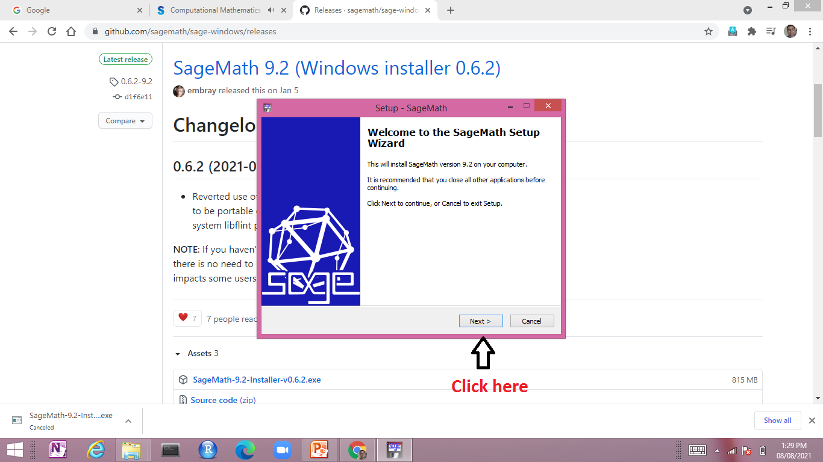

Slide 9
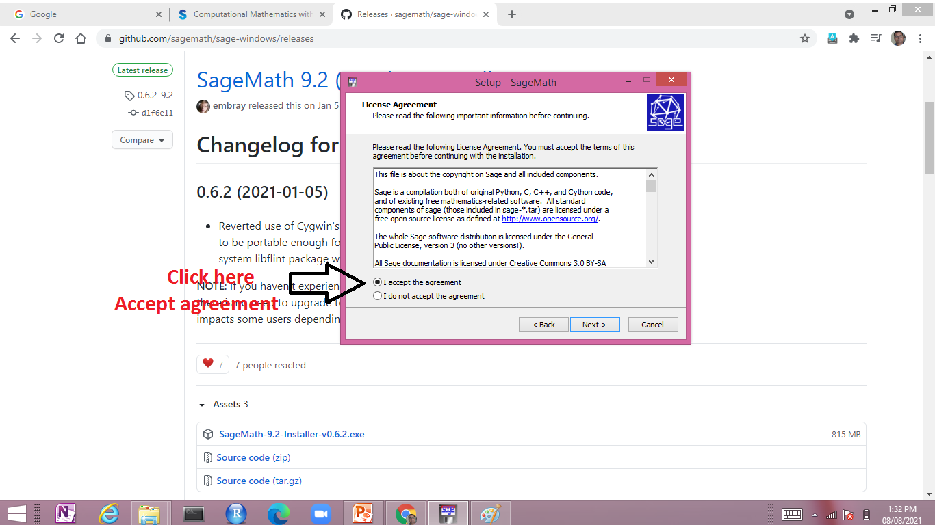

Slide 10
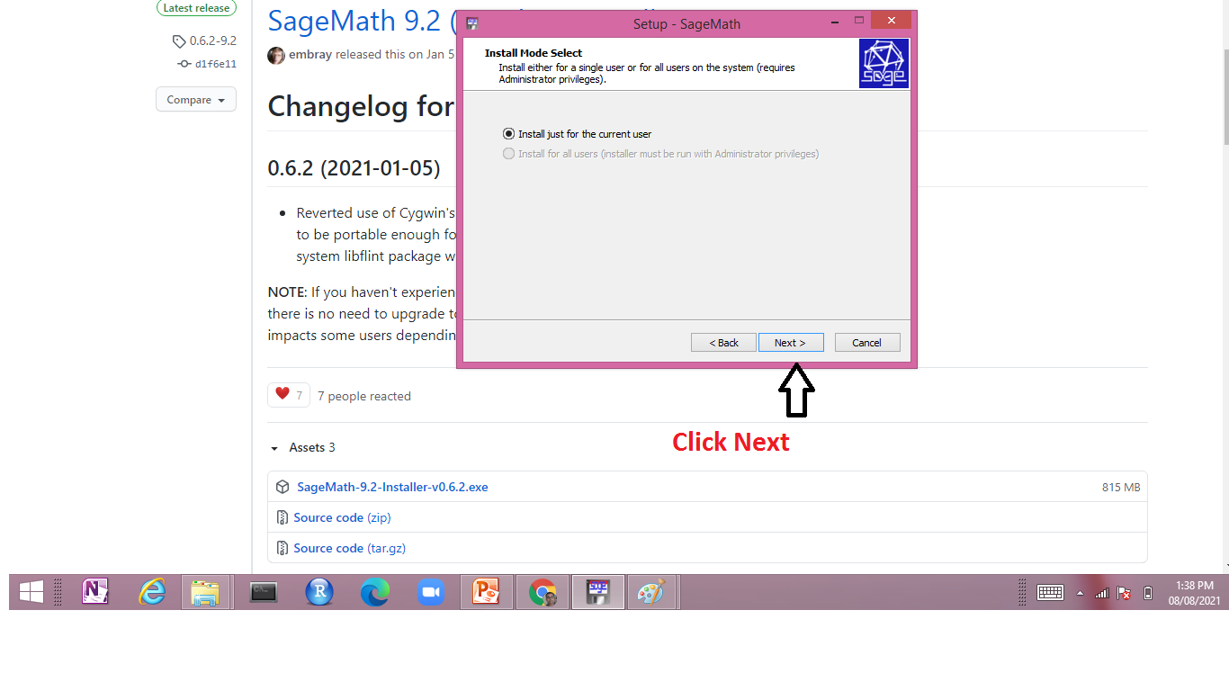

Slide 11
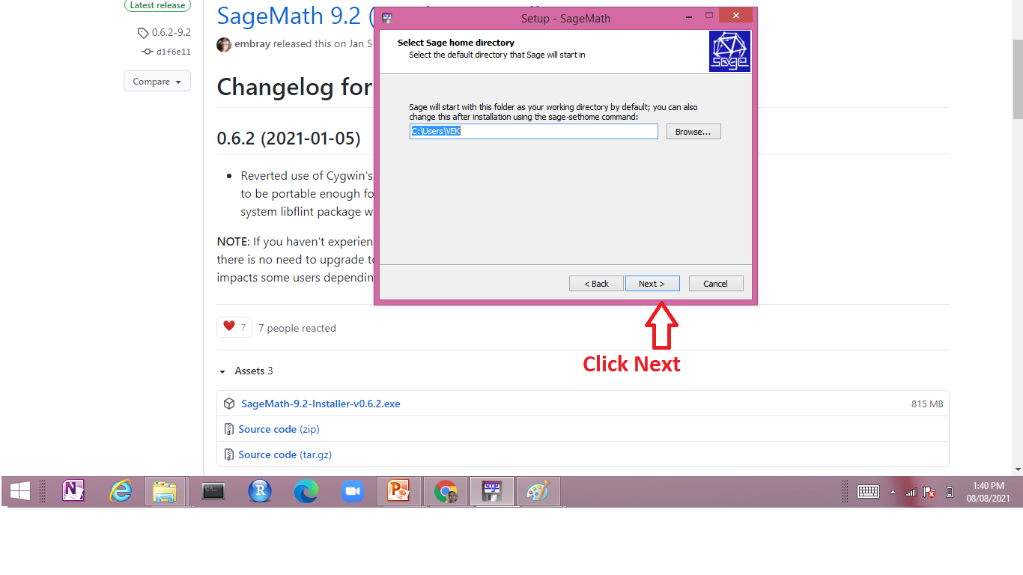

Slide 12
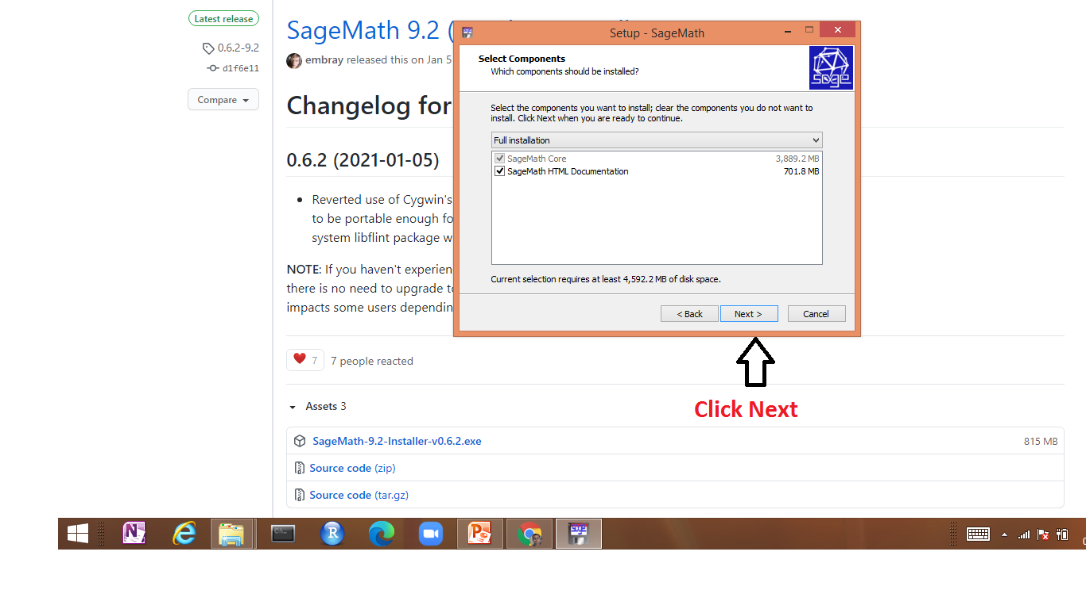

Slide 13
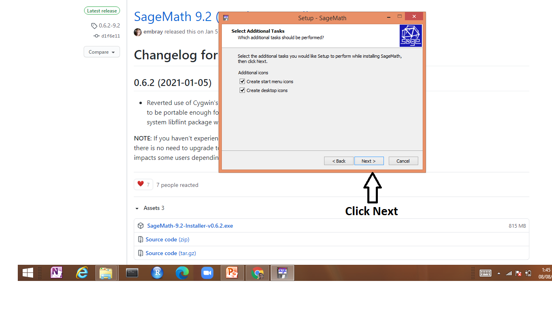

Slide 14
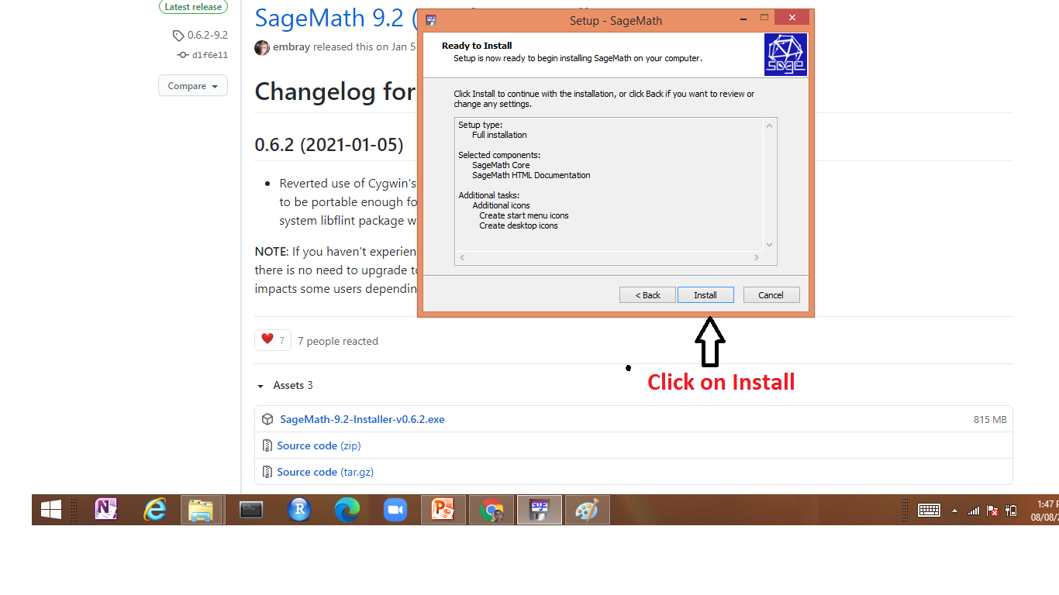

Slide 15
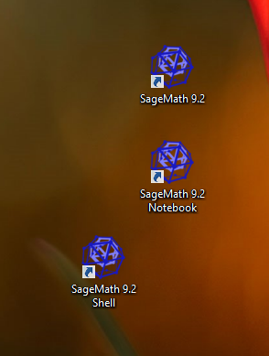
EXAMPLE-2
After installation you will get three icon on desktop. This complete your installation.

Slide 16
Source
NPTEL Course : Computational Mathematics with SageMath by
By Prof. Ajit Kumar
Institute of Chemical Technology, Mumbai
https://www.youtube.com/watch?v=Pmx-RdCHoXw&t=3s

